Slide 1
L09 – Deployment and postdeployment
FIT2101: Software Engineering Process and Management
S2 2020

Slide 2
In this lecture…
What happens after the project is complete?
Software deployment
Keeping the system running

Slide 3
After the project is complete…
When you’re a programmer, it’s easy to forget that the software you create will continue to exist after the project is complete – but in fact, if your software is successful, that’s only the beginning of the story.

Slide 4
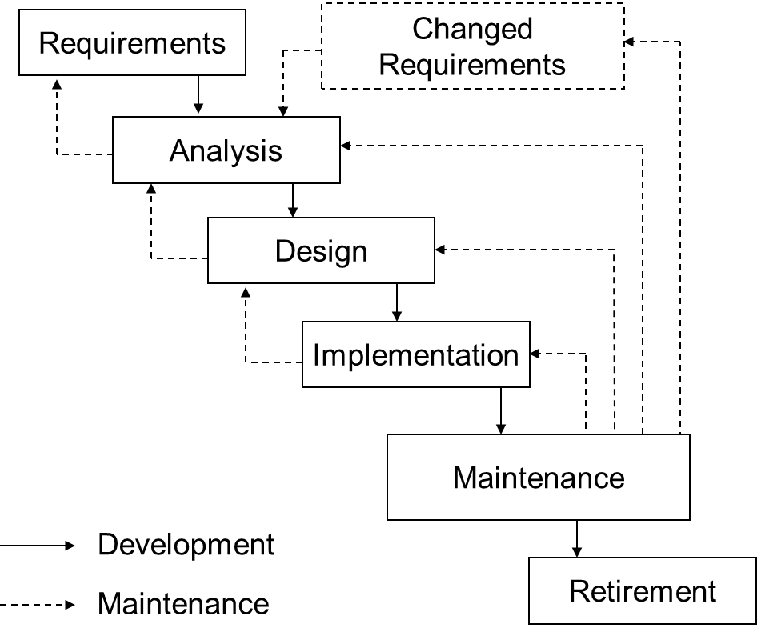
Remember the Waterfall model?
Today, we’re only looking at this bit
Notes:
Most software engineers mainly focus on what comes before maintenance, but it’s important to understand what happens after the software is complete.

Slide 5

Getting your software out there
Your software isn’t really complete until it is in the hands of its users. This might mean that it must be packaged for installation, or handed over to a production support team.

Slide 6
Packaging
When developing, you probably run your software by clicking the Run icon in your development environment
but your users won’t want to run your program that way!
If you’re writing an application for end users to download, you’ll need to create an executable file for them
possibly also an installer and installation instructions

Slide 7
Deployment
To deploy a piece of software means to make it available for use
you “deploy” software to your own computer by simply installing it
Deploying network-based software is trickier
involves maintaining a server
security becomes an issue, especially if the software is accessible from the wider internet

Slide 8
Continuous deployment
With continuous integration, the software is built and tested every time changes are made
for teams that use git, this typically happens when changes are pushed to master
Continuous deployment takes this process one step further
changes are not only built and tested
they are deployed, either to a staging server or to production

Slide 9
Delivering mobile apps
Mobile apps are usually delivered by putting them on the relevant app store
Google Play for general Android apps
third party stores such as Samsung App Store or Amazon App
iOS App Store for iPhones
The app must be packaged for delivery and is then submitted to the store
The store reviews the app:
compliance with the provider’s UI guidelines
compliance with the provider’s Terms of Service, e.g. not showing objectionable content, not spamming, etc.
this process is done by humans, so takes days to weeks
If accepted, the app becomes available for download on the app store
Notes:
Instructions for submitting iOS apps to the App Store: https://developer.apple.com/library/content/documentation/IDEs/Conceptual/AppDistributionGuide/SubmittingYourApp/SubmittingYourApp.html
Pre-submission checklist for submitting Android apps to Google Play: https://developer.android.com/distribute/best-practices/launch/launch-checklist.html

Slide 10
Delivery in large organizations
So far, we have only considered standalone programs
In large enterprises, such as telcos, financial institutions, airlines, major retailers, things can be much more complicated
the software you write sits alongside many other pieces of software
it’s not just a single program but a complex software ecosystem
Each program or project that developers create is a component in this system
Components are connected by scripts and small programs usually called glue

Slide 11
Operations
Operations staff keep the systems running in large enterprises
They deal with planned events
deploying, upgrading, and decommissioning components of the system
performing maintenance on hardware and software systems
writing and maintaining glue code
They also deal with unforeseen events
responding to errors caused by bugs
responding to natural disasters
proactively combing logs and conducting checks to ensure that everything is working
Operations employs IT professionals with a wide range of skills
programmers, DBAs, tech support, network engineers, production support engineers, system administrators, etc.
Notes:
Re natural disasters: the SEA-ME-WE3 data cable that connects South-East Asia, the Mediterranean, and Western Europe was severed in mid-2017 as a result of a typhoon. If you didn’t notice this, you should thank the operations and support staff at your telco, bank, ISP, etc.

Slide 12
Operations and support staff see the system in a way that nobody else does
they don’t know the architecture of each individual component, but they understand how the components work together
they see every software component in the system
plus the glue that holds them together
they get to see first-hand how users interact with the system
they are often the first to detect errors
and the first to diagnose them, come up with workarounds for them, or fix them
they know which defects currently exist in the system
they know which defects used to exist in the system

Slide 13
Operations and maintenance are hard
Enterprise systems tend to evolve toward complexity over time
It is (almost always) harder and more time consuming to read and understand someone else’s code than it is to write a replacement from scratch
This is especially true if the original developers have moved on to new projects, or even to a new company
this is very likely if they were consultants
So companies often handle changing business requirements by starting up a new project
which must then be integrated into the existing software ecosystem
The lifecycle and architecture of each component in the system may be straightforward but the lifecycle and architecture of the system itself are complex

Slide 14
Software and systems
Here is a thought experiment: imagine that a university (like this one) rolls out a new student information system
keeps track of each student’s personal details, fee status, etc.
also stores students’ results

Slide 15

January
The team finishes the system in plenty of time for enrolment in February
they have a barbecue to celebrate
then move on to other projects
The system has a web-based front end over a SQL database
the database pulls some marks in from Moodle
UI
Moodle
SQL DB

Slide 16

February
“The School of Agriculture wants to switch to Blackboard, can we get our marks data from there as well?”
this is doable, but most of the original team are unavailable
semester starts in a few weeks, we don’t have time to modify the existing system
so we’ll write a standalone Blackboard wrapper
Blackboard
UI
Moodle
SQL DB

Slide 17

March
“The Department of Immigration wants information on student visa holders.”
we can get this info from our database, that’s easy
modifying the UI would be harder and we’d have to redo our user acceptance tests
this is simple, so let’s write a separate web-based UI to get this report out
Blackboard
UI
Moodle
SQL DB

Slide 18

April
“Great news! We’ve reached agreement with a overseas partner university to create a shared degree offering!”
so now we’re going to have to integrate with their student information system
which uses a different database
Blackboard
UI
UI
Moodle
SQL DB
IBM DB2

Slide 19
May
“Two hundred students are transferring in from another uni, can we read their data in from a CSV file so that we don’t have to retype it all?”
okay, let’s write a CSV importer…
Blackboard
UI
UI
Moodle
SQL DB
IBM DB2

Slide 20
June
“Employers tell us the marks aren’t enough by themselves. We want to know how well students are doing at each Unit Learning Outcome”
need to keep track of the relationship between ULOs and marks…
and write a report form as well…
Blackboard
UI
UI
Moodle
SQL DB
IBM DB2

Slide 21
July
“Why is this system so complicated and slow?”
Notes:
None of these changing requirements seem unreasonable in themselves, and it’s true that creating new projects is likely to lead to faster delivery than modifying the original – but it comes at a cost. The individual components may be well-engineered, but the way they have been integrated has given rise to technical debt.

Slide 22
Operations considerations
Operations and support staff need to be considered when developing software that will be deployed in a complex enterprise environment
software needs to be easy to deploy and update
when the software goes wrong, they need to be able to detect and diagnose the problem
logging helps with this!
components need to be able to coexist within the system without overrunning or blocking one another’s resources
components should report errors clearly, unmistakeably, and promptly
We will look at some of the ways that operations and development staff work together in the next lecture

Slide 23
Summary
Handover and deployment
How enterprise architectures evolve
Meeting postdeployment needs

Slide 24
Next lecture
Metrics and evaluation

